Slide 1
Prerequisites for MuleSoft
23–March-26

Slide 2
yf3vhkbvj
yf3vhkbvj

Slide 4
What is Web-services?
A Web service is a way for two machines to communicate over a network using HTTP/HTTPS protocols. It enables interoperability and data exchange.
What is an API?
API stands for Application Programming Interface. APIs allow data exchange between systems.
Web-services vs APIs
Every web service is an API, but not every API is a web service. APIs evolved from web services for information transfer.
What is MuleSoft?
MuleSoft is a Salesforce company offering an Integration and API Management Platform. Its runtime engine, Mule, is a lightweight Java-based ESB enabling easy system integration using technologies like JMS, Web Services, JDBC, HTTP, etc.
API Management Platform
Includes designing, developing, deploying, managing, securing, and reusing APIs.

Slide 5
Protocol: A set of rules that define how data is transmitted and received over a network.
HTTP Protocol: Hyper Text Transfer Protocol is the foundation of data communication on the web, enabling communication between clients and servers.
HTTP Message: Data exchanged between client and server, consisting of requests (from client) and responses (from server), each with headers and an optional body.
Request/Response:
Request: Sent by the client to ask for data or perform an action.
Response: Sent by the server with the requested data or result of the action.
Payload: The actual data or content carried in the body of an HTTP message (request or response)
HTTP Methods-
GET- Retrieve data from the server without modifying it.
POST-Send data to the server to create a new resource.
PUT- Update or replace an existing resource.
PATCH-Used to partially update an existing resource on the server.
DELETE-Remove a resource from the server.
Query Params - Added to the URL after a ? (e.g., /products?category=shoes).Used to filter, sort, or search resources.
URI Params- (Uniform Resource Identifier) - Part of the URL path (e.g., /products/123).
Used to identify a specific resource.

Slide 6
HTTPS (Hyper Text Transfer Protocol Secure):
A secure version of HTTP that encrypts data between the client and server using SSL/TLS, ensuring privacy and data integrity.
Common Ports-
8081- Default Mule HTTP Listener
80- HTTP
443- HTTPS
Common Status Code used:-
200 – OK: Success
201 – Created: Resource created
204 – No Content: Success, no content to return
400 – Bad Request: Invalid request
401 – Unauthorized: Authentication required
403 – Forbidden: Access denied
404 – Not Found: Resource not found
409 – Conflict: Request conflict
500 – Internal Server Error: Server error
503 – Service Unavailable: Server temporarily unavailable

Slide 7
Content-Type
Specifies the media type of the resource or data in HTTP headers.
Examples:
application/Json (JSON data)
text/html (HTML content)
application/xml (XML data)
multipart/form-data (file uploads)
text/plain (plain text)
Inbound Webservice vs Outbound Web Service
Inbound webservice is when request comes into your system.
Outbound Webservice is when you request some external systems.

Slide 8
REST VS SOAP
Feature | REST API | SOAP
Full Form | Representational State Transfer | Simple Object Access Protocol
Data Format | JSON, XML, HTML, Text (mostly JSON) | Only XML
Architecture Type | Architectural style | Communication protocol
Flexibility | More flexible | Very strict standards
Performance | Faster (lightweight) | Slower (heavy XML)
Security | Uses HTTPS, OAuth | High enterprise security (WS-Security)
Usage Style | CRUD via HTTP (GET, POST, PUT, DELETE) | Operations defined in WSDL
Messaging | Request-response | Request-response + extra protocols
Industry Usage | Web apps, Mobile apps | Banking, Telecom, Government
Learning Curve | Easier | Harder

Slide 9
MuleSoft Coding Standards & Naming Conventions

Slide 10
MuleSoft Naming Conventions
Project, Flow, Sub flow, Property File Names
kebab-case
(e.g., uhub-sapi, register-covid-case, uhub-sapi-dev.yaml)
Variable Names
camelCase
(e.g., covidCasePayload)
JSON / XML Field Names
Capital Camel Case (e.g., StreetAddress)
kebab-case (e.g., street-address)
snake_case (e.g., street_address)
camelCase (e.g., streetAddress)
Connector Names
First letter capital, spaces between words
(e.g., Transform Message)
REST API Resource Naming
Use plural nouns, avoid verbs/abstract nouns
Single word: lowercase (e.g., /cases)
Multiple words: kebab-case (e.g., /covid-cases)
Field names: camelCase
(e.g., /patients/4535?firstName=John)
Best Practices
Consistent, descriptive, and intuitive names
Follow standards for reusability and clarity

Slide 11
MuleSoft Best Practices
API & Design
Follow API-led connectivity (System, Process, Experience APIs)
Use REST standards and proper HTTP methods
Version APIs (e.g., /v1/, /v2/)
2. Reusability
Create reusable sub flows and DataWeave scripts
Use shared libraries for common logic
Avoid duplicate implementations
3. Error Handling
Use Global Error Handler
Implement On Error Continue / Propagate appropriately
Log meaningful and clear error messages
Do not expose internal errors to clients
4. Security
Use HTTPS for all communications
Apply OAuth 2.0 / Client ID enforcement
Store sensitive data using secure
5. Properties
Avoid hardcoding credentials

Slide 12
MuleSoft Best Practices
9. Deployment
Use CI/CD pipelines for deployment
Maintain separate environments (dev, qa, prod)
Use environment-specific property files
10. Modularity
Break large flows into smaller sub flows
Follow single responsibility principle
Keep flows simple and maintainable
11. Naming Conventions
Use consistent naming for flows, variables, and APIs
Keep names descriptive and meaningful
6. Performance
Use streaming for large payloads
Avoid unnecessary transformations
Use parallel processing where applicable
Cache frequently used data
7. Logging & Monitoring
Use structured logging (INFO, ERROR levels)
Avoid logging sensitive information
Use correlation IDs for request tracing
Integrate with monitoring tools
8. Testing
Write MUnit test cases for all flows
Cover both success and failure scenarios
Mock external systems

Slide 13
MuleSoft Complete Concepts
Covers Platform, Flows, Processes, Services, Components, Connectors, Configs, Deployment, and More

Slide 14
What is MuleSoft
Integration & API platform
Connects applications, data, and devices
Enables API-led connectivity

Slide 15
What is Integration ??
Integration connects different systems and applications for seamless data exchange.
MuleSoft’s Anypoint Platform enables building and managing APIs and integrations.
It helps automate workflows and synchronize data across cloud and on-premises environments.

Slide 16
Anypoint Platform Modules
Design Center
Anypoint Exchange
API Manager
Runtime Manager
Monitoring & Logging
Visualizer
Secrets Manager
Anypoint Studio

Slide 17
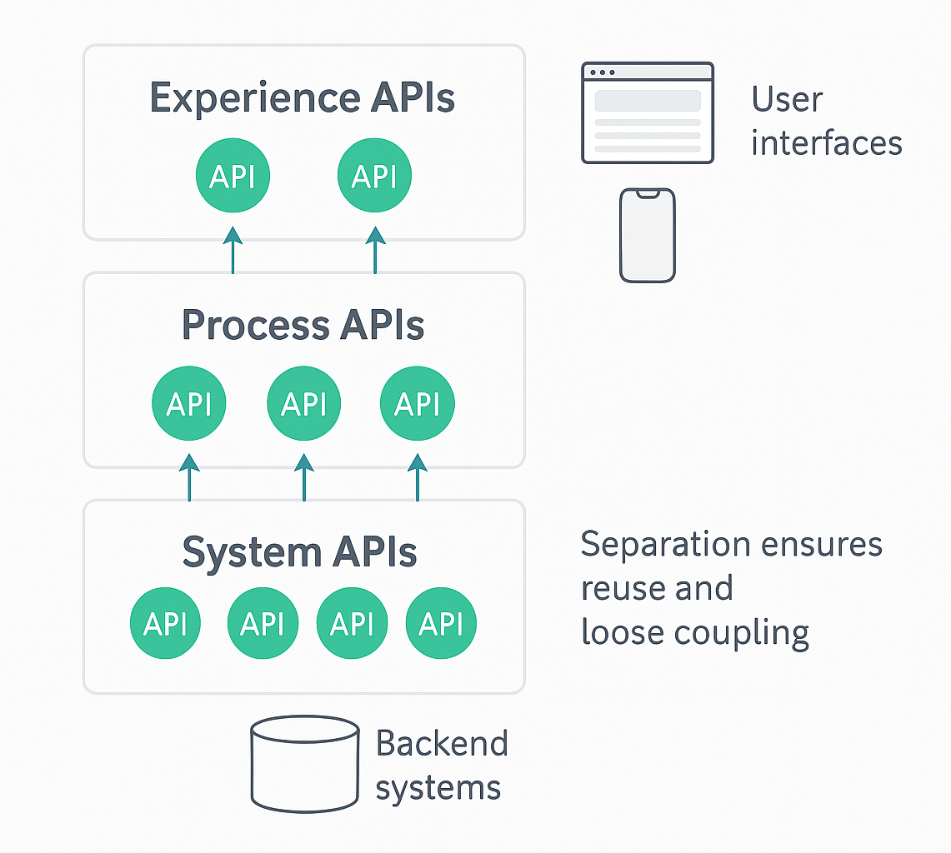
API-Led Connectivity Layers
System APIs → connect to backend systems
Process APIs → apply business logic
Experience APIs → deliver data tailored for each app
Separation → ensures reuse & loose coupling

Slide 18
Receives Event
Transforms Data
Enriches/Routes
Invokes Services
Returns Response
Mule Application Flow

Slide 19
Event & Mule Message
Event contains
Message (payload + attributes)
Variables
Error
Message payload transformed via DataWeave

Slide 20
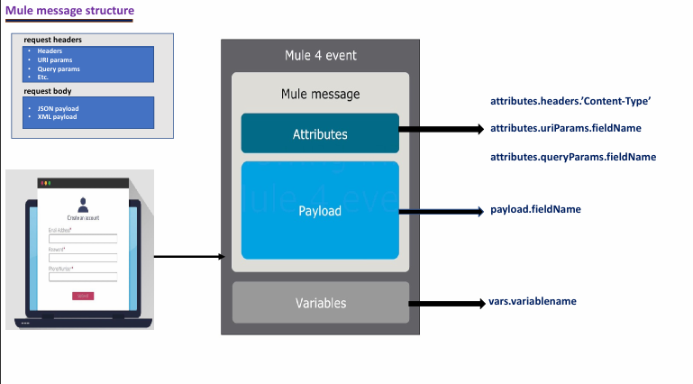

Slide 21
Components & Connectors
Components & Connectors
Connectors: HTTP, DB, FTP/SFTP, Salesforce, JMS, Kafka, SMTP
Components: Logger, Transform, Set Variable, Validators
Routers: Choice, Scatter-Gather, Round-Robin
Scopes: Try, Async, For Each, Parallel For Each

Slide 22
Common Connectors with Connection Names
HTTP Connector
Listener Config (HTTP_Listener_Configuration)
Request Config (HTTP_Request_Configuration)
DB Connector
Configuration (DB_Config)
Salesforce Connector
SF_Config
FTP/SFTP Connector
SFTP_Config
JMS/Kafka
JMS_Config or Kafka_Config

Slide 23
Global Configuration Elements
Element | Purpose/Use Case
Connector Configs | Reusable connections
TLS Config | Secure communication
Property Placeholders | Externalized configuration
Error Handler Global | Centralized error handling
Scheduler Config | Scheduled tasks
Object Store Config | Persistent storage
HTTP Listener/Request | API endpoints/integrations
Logger | Standardized logging
Transformers | Data transformation
Caches | Data caching
Flows/Sub-Flows | Reusable logic
API Autodiscovery | API management
Security Policies | Custom security
Filters/Validators | Input validation/filtering

Slide 24
Variables, Attributes, Properties
flowVars: variables within flow
sessionVars: deprecated
attributes: metadata (headers, query params)
property files : environment configs

Slide 25
DataWeave Transformation (MuleSoft)
Powerful data transformation language used in “Transform Message”
Supports JSON, XML, CSV, Java Objects, and more
Transforms both message body (payload) and headers (attributes)
Functional programming: map, filter, reduce, custom functions
Enables fast, modular, and reusable data mapping across formats

Slide 26
Routers & Scopes (MuleSoft)
Routers: - Choice: Conditional routing (if/else logic) - Scatter-Gather: Parallel processing, aggregate results - First Successful: Tries routes in order, uses first success - Round Robin: Distributes messages evenly (load balancing) - All: Sends message to all routes (like multicast)
Scopes: - Try: Error handling block - Async: Run flow in background - For Each: Loop over collection - Parallel For Each: Loop with parallel execution - Until Successful: Retries block until success or max attempts - Cache: Store and reuse results for performance
Purpose:
- Control flow, error handling, parallelism, and performance optimization in Mule flows

Slide 27
Error Handling Types
Error Handling Types
On Error Continue
On Error Propagate
Try Scope
Global Error Handler
Custom error objects

Slide 28
Batch Processing: Designed for handling large data volumes (e.g., files, records) Processes data in steps: Input → Process → On Complete Supports parallelization, checkpointing, and error handling Enables partial processing and recovery from failures Streaming: Handles large payloads efficiently (e.g., big files, large API responses) Processes data as it arrives, without loading all into memory Reduces memory usage and improves performance Supports streaming for file, HTTP, and database connectors Benefits: Scalable, efficient processing of big data Parallel execution and fault tolerance Optimized resource usage
Batch Processing & Streaming (MuleSoft)

Slide 29
Deployment Models
Cloud Hub
On Premises Runtime
Runtime Fabric (RTF)
Hybrid deployments
Managed via Runtime Manager

Slide 30
Monitoring & Logging
Built-in Logs
Anypoint Monitoring
Dashboard & Alerting
Distributed tracing via Visualizer

Slide 31
Security & Policies
OAuth 2.0, Basic Auth
Client ID Enforcement
Rate Limiting
SLA Tiers
TLS Mutual Auth

Slide 32
API Versioning & Reusability (MuleSoft Best Practices)
Major.Minor.Patch Structure: • Follows semantic versioning (e.g., 1.2.3) • Major: Breaking changes • Minor: Backward-compatible enhancements • Patch: Backward-compatible bug fixes
APIs and Schemas Reusable via Exchange: • Publish APIs, RAML/OAS specs, and data schemas to Anypoint Exchange • Promotes reuse across teams and projects • Centralized governance and discovery
Best Practice for SAFe (Scaled Agile Framework) & Microservices: • Supports scalable, modular architecture • Enables independent deployment and evolution • Facilitates collaboration and agility in large organizations.

Slide 33
CI/CD & DevOps
Mule Maven Plugin
Automated deployment pipelines
Supports Git, Jenkins, Azure DevOps, GitLab, Bitbucket

Slide 34



